Slide 1
Pandas II
Day 11
The Data Boot Camp |
December 04, 2018

Slide 2
Agenda
Navigate through DataFrames using Loc and iLoc
Filter and slice Pandas DataFrames
Create and access Pandas GroupBy objects
Sort DataFrames

Slide 3
Exploring Data with loc and iloc

Slide 4
loc and set_index()
.loc and .iloc allow develpers to collect specific rows/columns of data from a DataFrame.
loc() allows its users to select data using label based indexes. In other words, it takes in strings as the keys and returns data based upon that, therefore…
using loc() to search through rows is only really useful when the index of a dataset is a collection of strings.
It is almost always useful when selecting data from columns because column headers are exclusively strings.
Using the df.set_index() function passing in the desired column header as the argument to accomplish this.

Slide 5
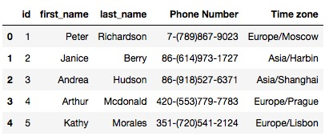
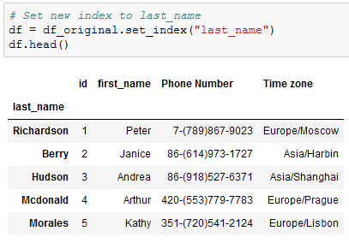
Before and After df.set_index()

Slide 6
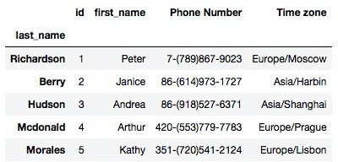
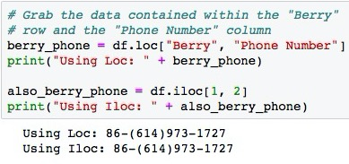
iloc
.iloc[ ] provides the same feature as that of loc() but instead of using labels, it instead uses integer based indexing for selection by position. Similarly to selecting data from within a list, iloc uses a numeric index.
df.iloc [row, col]
df.iloc [1, 2]

Slide 7
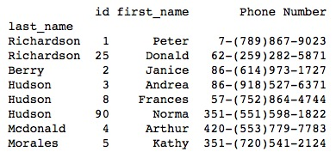
Selecting Muliple Rows and Columns
loc[
["Richardson", "Berry", "Hudson", "Mcdonald","Morales"],
["id", "first_name", "Phone Number"] ]

Slide 8
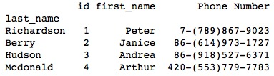
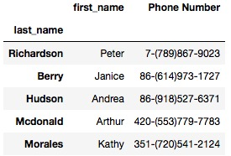
Selecting Muliple Rows and Columns
iloc[ : , : ] returns all rows and columns
iloc[0:4, 0:3]
iloc[ : , ["first_name", "Phone Number"] ].head()
loc returns duplicate when applicable
Iloc removes duplicate from the results

Slide 9
Conditonal

Slide 10
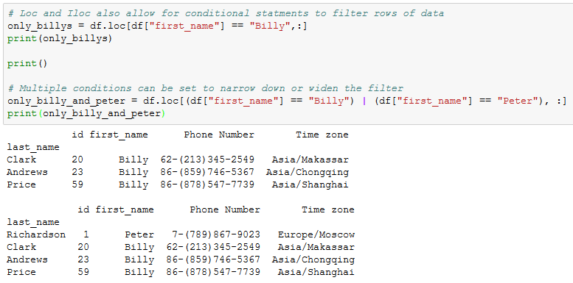
Compound Conditions
AND → &
OR → | returns all that are true

Slide 11
Cleaning Data
When dealing with massive datasets it is almost inevitable that duplicate rows, inconsistent spelling, missing values will crop up. While doesn’t seem significant these problems can severely hinder the analysis and visualization of a dataset by skewing the data one way or another.
Pandas porvides these functions to mitigate the problem:
DatatFrame.count() used to identify missing value – giving the total rows that do not contain NaN
del DatatFrame[ colname ] used to delete column
DataFrame.dropna(how="any") used to delete rows with missing info
DataFrame.fillna(value=<value>)

Slide 12
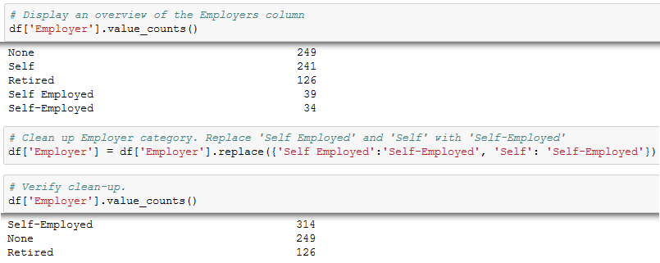
Replacing Data
Sometimes the rows containing "NaN" values should not be removed but should instead be filled with another value.
DataFrame.replace("orig value" : "new value", …)
DataFrame[columnName].value_counts() returns unique entries in series and useful to find values that have similar/misspelled values

Slide 13
Grouping

Slide 14
Refer to notes on GroupBy.ipynb
Gitlab/../Instructor Notes/PandasWk3.2/

Slide 15
Sorting

Slide 16
Refer to notes on Sorting.ipynb
Gitlab/../Instructor Notes/PandasWk3.2/
https://pandas.pydata.org/pandas-docs/stable/api.html

Slide 17
Questions / Discussion
Notes:
It’s important to keep in mind why you joined this class. Let’s talk about your goals.

